Slide 1
Needfinding
Studio: Food
Presented By: Clay Jones

Slide 2
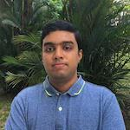
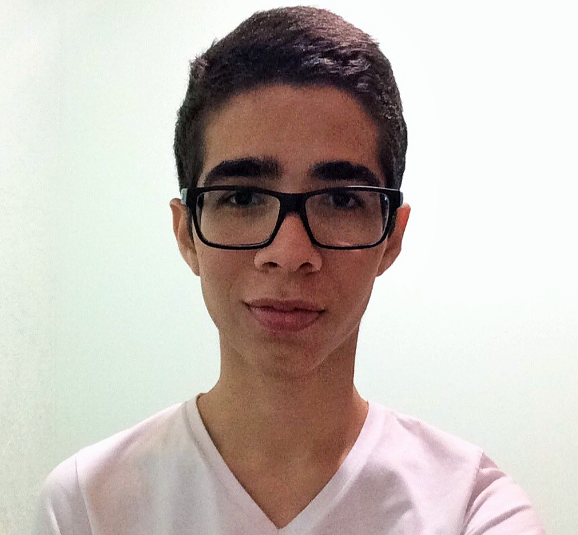
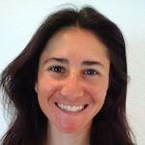
The Team
Senthilnathan Viswanathan
Jesse Candido
Lindsey Kostas
Clay Jones

Slide 3
250 | 10 | 4 | 1
Minutes | People | Locations | Commonality

Slide 4
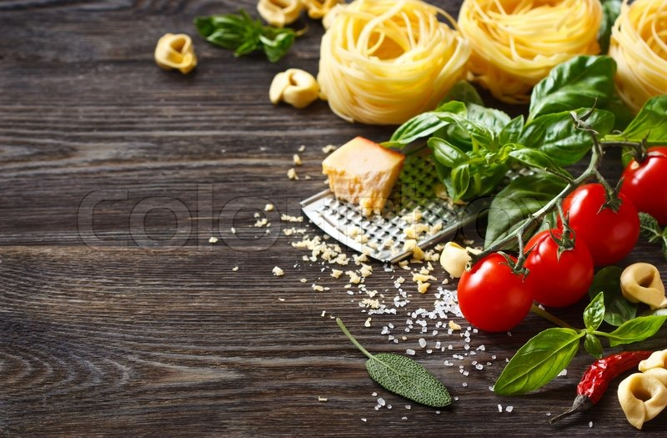
Active Lifestyles
How does the active community think about food?
Notes:
Single slide, active lifestyle domain

Slide 5
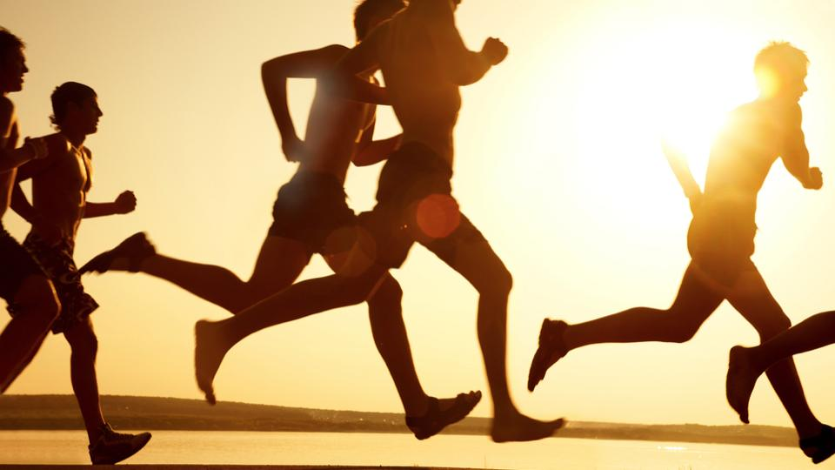
Davis - the overbooked associate
Dora - the master planner
Elaine - the routined eater
Ellie - the health nut
Evan - the olympic athlete
Jessica - the reluctant chef
Joel - the mood eater
Jonathan - the average joe
Justina - the new mom
Richard - the young professional
Notes:
Names of interviewees (maybe age and occupation/short description)

Slide 6

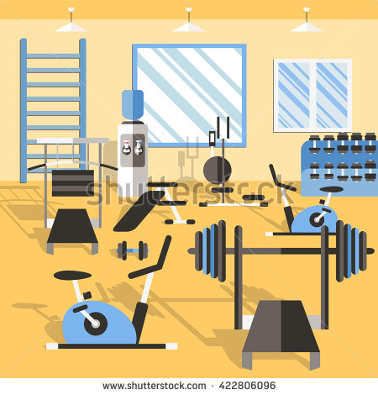


Where Do They Go?
The Alternative Trainers
The Fashionista
Gym Rats
Ellie, Elaine, Jessica
Joel
Davis, Dora, Evan, Jonathan, Justina, Richard
Notes:
Why they were chosen, how recruited, when and where they were found
Why did we go to these places and at these time? - Because we want diversity!!!!

Slide 7
When Do They Go?
Early Birds
Early Evening
Late Afternoon
Night Owls
Ellie, Elaine, Dora, Davis
Jonathan, Justina
5:30 AM - 7:30 AM | People Have Lives | 4:00pm | 7:30PM | 9:00PM
Jessica, Joel, Evan
Richard
Notes:
Why they were chosen, how recruited, when and where they were found

Slide 8
How Do They Fuel Up?
Environment
ELLIE
Richard
Evan
Justina
Jessica
Variety
DAVIS
Ellie
Justina
Disciplined
DORA
Elaine
Jessica
Conflicted
RICHARD
Joel
Jonathan
Notes:
Categories… the first one has its eating habits shaped by those around them. The second tries do diversify their food, the third is very strict and the fourth is unhealthy.
Variety - They want variety

Slide 9


We Asked...
Lifestyle
Describe your lifestyle
Walk us through a typical day
How do you keep yourself active?
Food
What kind of eater would your friends describe you as?
Best/worst eating experience?
How do you think about food?
Notes:
Questions we asked

Slide 10
And They Answered...
“It would be a lot easier if he liked what I liked” - Ellie
“The group always chooses where we get to eat” - Richard
“I’m not used to having so many good things to choose from” - Ellie
“If I don’t have those three things in my fridge I will not be happy” - Dora
“You get stuck in a routine, you only cook 3 things” - Davis
Notes:
Read ellie quote
They has varing different responses based on how they dealt their eating habits.

Slide 11
But They Weren’t Always Consistent...
Ellie: “I would go out less and cook more...sometimes I don’t want to spend the time researching [what I’m going to cook]”
Davis: “Enduring challenge of coming up with new and interesting things to cook...I don’t like going home to cook”
Dora: “It’s all about having a structured meal...I love eating out and trying new restaurants”
Richard: “I would like to get back in shape… I don’t have the motivation to eat healthy and work out”
Notes:
Read ellie quote

Slide 12
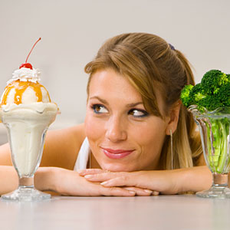
And Sometimes Even Surprising...
Define HEALTHY?
Where are you eating?
Notes:
Different perspectives of what healthy eating is - variety, simplicity, amounts
Balance is healthy others thought eating veggies is important
People had different viewpoints when eating at home or eating out with friends

Slide 13
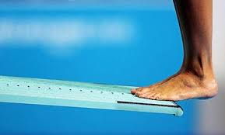
Diving A Little Deeper
Notes:
Transition to ANALYSIS… 4 next slides are empathy maps, each person a color

Slide 14
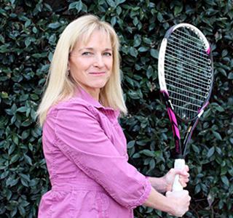
Meet ELLIE
Late-50’s
ZOOM Marketing CEO and founder
Lives w/ husband Mike in Palo Alto
PSYCHO-active TRENDY vegetarian
LOVES cooking
Notes:
Husband isn’t veggie

Slide 15
“What I make and I’m excited about making is like so-so for him” | One of us always ends up eating something we don’t want
laughed when she talked about food she has to cook to satisfy her husband | frustrated and constrained
SAY | THINK
DO | FEEL
Notes:
Environment .
Either one person is happier while the other isn’t
Her husband found it funny that he had to eat veggies

Slide 16
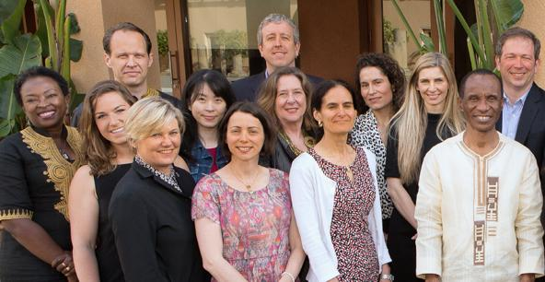
Meet DAVIS
mid-30s
Global Operations, Stanford SEED
Lives w/ wife in San Francisco
10hr+ work days, 30%+ travel
Active every day
Notes:
Workaholic, travels all the time, makes sure goes to the gym 5 days a week

Slide 17
“I like lots of little things to try rather than one plate of a big thing” | I wish there was an easier way to keep eating interesting
Running to work, carrying all his belongings in his arms | tired and stuck in a rut excited to explore
SAY | THINK
DO | FEEL
Notes:
Variety
He has a different way of thinking about health
He thinks balance makes him feel healthy. He loves family oriented restaurants.
He wishes to keep eating something interesting.
He seemed active and like an on the go person. He felt tired because he couldn’t find time and the energy to keep himself interested.
Major conflict

Slide 18

Meet DORA
Early-30’s
New job at a drone startup
Lives w/ boyfriend in San Francisco
LOVES food
Turrets Syndrome
Mindful
Notes:
Cooks for boyfriend
Focused on food she eats. Everyday she is eating a very disciplined food.

Slide 19
“I know the core items I need to make my meals” | Eating the same thing everyday makes my life easier
assertive and immediate responses | confident and proud
SAY | THINK
DO | FEEL
Notes:
Discipline
She was happy with eating same thing. Eating certain kinds of food exacerbates her ticks condition, while others keep her calm.
She wasnt ashamed of anything. But the one catch with Dora , is she has guilty pleasures once a week (duck fat, cheese and wine)

Slide 20
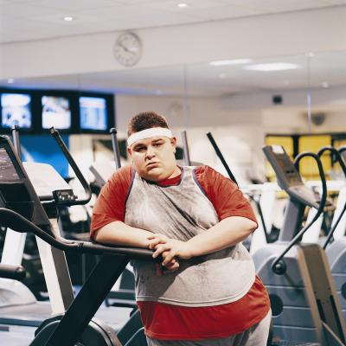
Meet RICHARD
mid-20s
New grad - CITI Bank
Lives w/ roommate in So Cal
Notes:
In a training pgm, and has to travel frequently. Has 75 dollar credit. When he was in college, he claims to be healthy. Once he started working he has stopped being healthy.

Slide 21
“The restaurant is always the group’s choice” | I have little control of my diet because of the people around me
Made jokes about being out of shape and awkwardly laughed | Unmotivated and embarrassed
SAY | THINK
DO | FEEL
Notes:
Unhealthy
Friends are ubering and driving together and richard has little control with that.
He knew that he could be in shape but he continued to make excuses.

Slide 22
Needs
Insights
Compromise
Excitement
A Better Way to Cheat
Accountability
Food causes CONFLICTS!!
Notes:
Needs and insights
Compromise - ellie- she is a veggie and husband isn’t , she needs to find balance, wants meal to find balance. Needs some form of compromise
Excitement- davis, busy, always doing everything related to food, wants exciting lifestyle with food, but doesnt have time or energy to make it exciting for him, We believe there is some way out there to fulfill his need
Disciplined - dora- ate foods she wanted to eat, proud of cooking, when it came to weekends she splurged on unhealthy things. We saw a better way to cheat for her that Keeps her healthy and still has a disciplined diet. She is on the opposite end of spectrum on weekends.
Accountability - richard- needs someone to hold him accountable, eat with everyone or eat healthy?
Insights - everyone has their own conflicts!!!

Slide 23
Questions?

Slide 24
INDEX
Notes:
People who call themselves “healthy” are proud about it and say it feels good

Slide 25
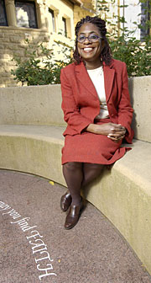
Meet ELAINE
mid-50’s
Stanford Vice Provost Office
Lives alone on campus
BeWell Program
Loves eating food

Slide 26
“when I go out is when I have the tasty food” “I ate too many of those potato chips” “I wish I took more time to enjoy the preparation” “I’m hungry when I get home” | I eat healthy out of habit and convenience, it isn’t something I really enjoy I wish I could just come home to dinner
laughed every time she said kale smiled when she talked about eating and food | regretful after splurging comforted by food proud of herself and habits nostalgic
SAY | THINK
DO | FEEL
Notes:
unhealthy

Slide 27
Meet EVAN
Early-20's
Stanford Varsity Volleyball
US Olympic Team

Slide 28
“Eating healthy was easy when I was surrounded by motivated people” | He felt accountable to his team and coaches (I owe it to my team to eat well)
raised voice and looked happy while talking | excited about his new diet accountable to his team and coaches
SAY | THINK
DO | FEEL
Notes:
unhealthy

Slide 29
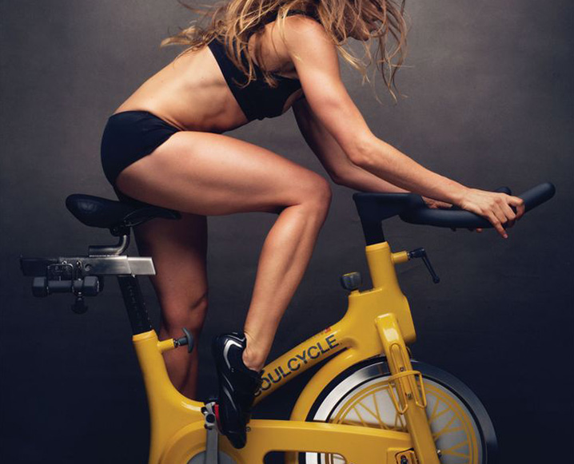
Meet JESSICA
Early-30s
Vegetarian
3 kids
Mother

Slide 30
“I have a daughter with tree nut allergy…so we eat a lot at home” “I plan all the meals in advance, on Sundays” | I wish someone else cooked for us, I hate cooking Planning ahead saves me time to exercise or take care of the kids
emotional about how her daughter’s allergy makes her cook more often instead of going out excited to talk about her health | fearful preoccupied with kids focused
SAY | THINK
DO | FEEL
Notes:
unhealthy

Slide 31
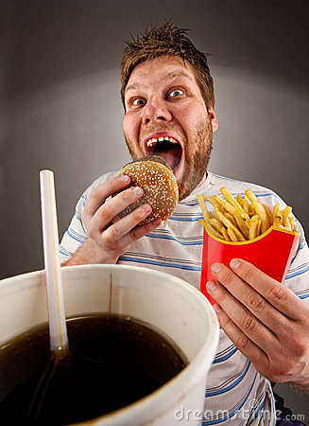
Meet JOEL
21
Does not exercise regularly
Works at a restaurant
Eats whatever he wants

Slide 32
“I just hate vegetables.” | I should include more greens in my meals, but the taste of most vegetables is just not appealing to me
avoided eye contact he stared at the floor the entire interview | too busy
SAY | THINK
DO | FEEL
Notes:
unhealthy

Slide 33
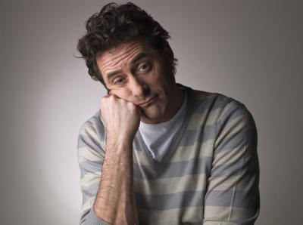
Meet JONATHAN
Average Joe
Stanford Alum
Works at a startup

Slide 34
“I wish I could stop having the temptation to eat all the time” “I love cookies, but brownies are my favorite” | I think about going to the gym,but it is so difficult to follow through.
laughed when his unhealthy lifestyle was pointed it out. | unmotivated lacking discipline
SAY | THINK
DO | FEEL
Notes:
unhealthy

Slide 35
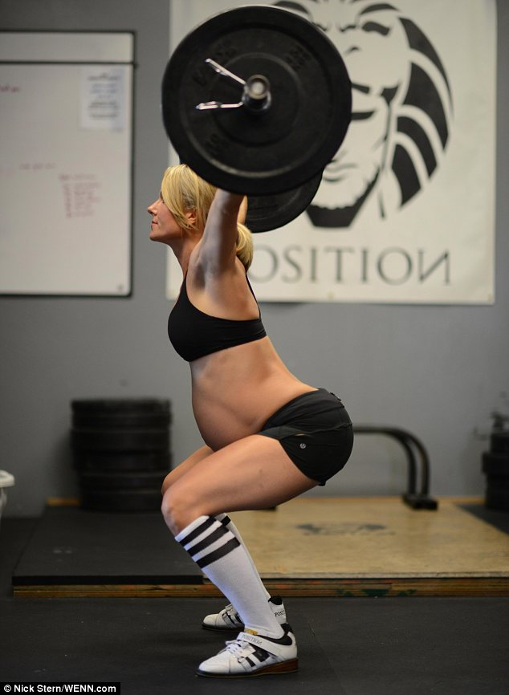
Meet JUSTINA
young mom
wants to lose the baby weight

Slide 36
“I have a daughter with tree nut allergy… she’s really young… I’m fearful for her to eat out… in case there’s… possible cross-contamination”
Jessica
Notes:
Summary… stock photos, or plain black

